Slide 1
What are institutions and how do we change them?
Brian Epstein
Boston Colloquium for Philosophy of Science, Boston University, October 2019

Slide 2
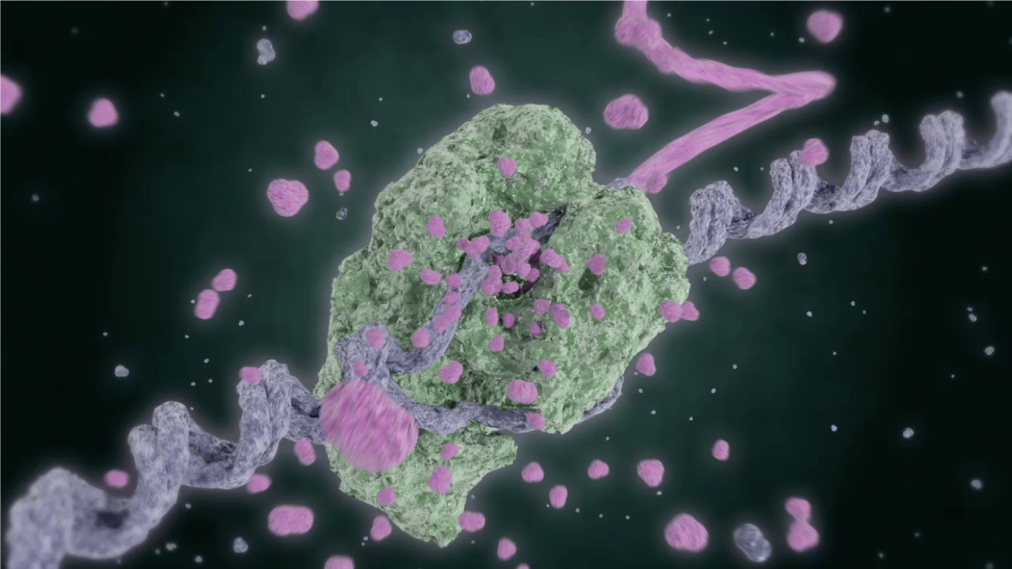
What is it? vs. How does it work?

Slide 3
Nature 4/17/2014-4/9/2015 (n=178)
American Economic Review 4/2014-5/2015 (n=242)
Notes:
Nature
AER
Natural scientists spending lots of time answering what is it
Social scientists, not so much
Why do these questions matter?

Slide 4
Social ontology
Focus on “what is it” questions regarding the social world
Aims:
Theoretical interest
But also aim to improve answers to “how does it work”
Understanding mechanisms
Institutions
Improving policy
Designing better institutions
”Meso” level
Compare to the physics of squishy stuff

Slide 5
Common pool resources: overexploitation
E.g., overgrazing

Slide 6
Common pool resources: underinvestment
E.g., fallow land

Slide 7
The social need
We want people to act as stewards, solve problems of common pool resources
We know that all are doing poorly under the current regime
We are confident that there are ways for most, if not all, to be better off

Slide 8
Ostrom on potential solutions
Government
Centralized assignments of stewardship and incentive provision
E.g., government pays bureaucrats to monitor and limit grazing, extract fines
Private property
Break up into parts/parcels/objects, create private attachments to each
Institute rights and obligations to one individual
Institute rights and obligations to collections of individuals
Shared systems of governance
E.g., system of rules for community to prevent overgrazing

Slide 9
Ostrom’s approach to self-governance
Common pool resource institutions in field settings
Communal tenure in high mountain meadows, Switzerland
Meadows and forests in Japanese villages
Irrigation canals and systems in Spain
Irrigation communities in the Philippines
Design principles exemplified by long-enduring communities
Hypothesis that these principles are necessary (though perhaps insufficient) conditions for achieving institutional robustness

Slide 10
Ostrom on the nature of institutions
“Institutions” can be defined as the sets of working rules that are used to determine who is eligible to make decisions in some arena, what actions are allowed or constrained, what aggregation rules will be used, what procedures must be followed, what information must or must not be provided, and what payoffs will be assigned to individuals dependent on their actions. (Ostrom 1990 p. 51; Ostrom 1986)
All rules contain prescriptions that forbid, permit, or require some action or outcome.
Working rules are those actually used, monitored, and enforced when individuals make choices about the actions they will take (Commons 1957)
One should not talk about a “rule” unless most people whose strategies are affected by it know of its existence and expect others to monitor behavior and to sanction nonconformance.
In other words, working rules are common knowledge and are monitored and enforced.

Slide 11
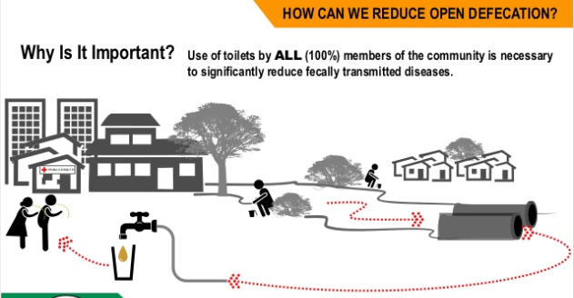
Open defecation in India

Slide 12
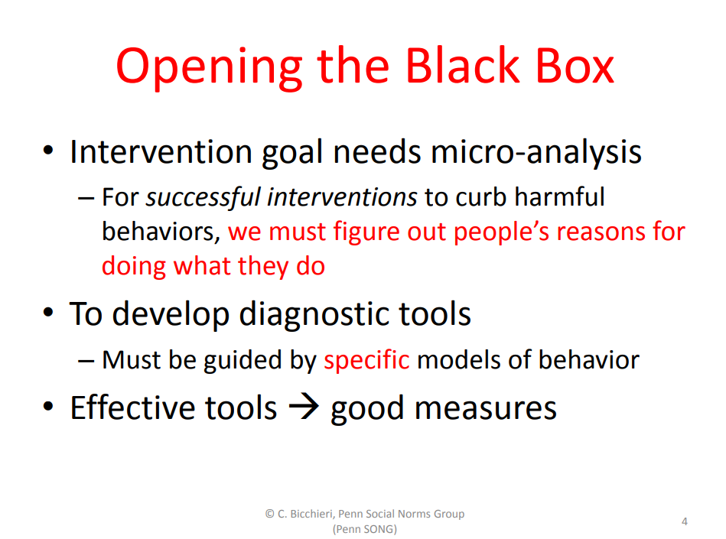
Open defecation: Bicchieri on norms
Intervene by cultivating social norms in community
Cognitive states

Slide 13
Institutions and social ontology
Importance of institutions
Hypothesis: our diagnosis and design of institutions has been stymied by a misunderstanding of the nature of institutions
Relevance of social ontology to practice
Designing for robustness

Slide 14
Two approaches to institutions
Institutions as infrastructure
World Bank projects
Institutions as cognitive
Analyses
Game-theoretic equilibria
Rules
Representatives
Institutional economics (Ostrom, Williamson, North)
Norms and conventions (Lewis, Bicchieri)
Dams, roads systems, power plants and electrical grid, housing projects
The second as a counter-reaction to the first
Over-reaction

Slide 15
The cognitive and individualist overreaction
Brian Epstein, Tufts University
Institutions as cognitive
Game-theoretic and individualist models
Still, we should not return to the “big project” picture of institutions
A new approach for heterogeneous institutions
Mixed ontology
New approaches to modeling

Slide 16
The “new materialism”
Practice theory (Bourdieu, Giddens, Schatzki, Rouse)
Materiality, flat ontologies (Barad, Latour, DeLanda)
Dissatisfied:
Hard to know what to do with it; not making much headway in analysis, modeling, policy
Some insights but also confusion and unclarity

Slide 17
What are institutions?
Something right in the cognitivist literature
The idea of an institution as transforming a situation, changing outcomes
But not right about changing one choice situation to another choice situation
Search for realizers of “transforming” functional role
Clarify the role, but do not identify the institution with this role
Good institutions may be non-cognitive
Misleading metaphor: institutions are choices of the rules by which to play the game
Rather, setting up pathways by which a function is normally performed
Realizer may be cognitive, but typically is heterogeneous

Slide 18
What are institutions?
Distinctions to be made
Role vs. realizer
Type vs. token
Single intervention (one incremental transformation or stratum) vs. a set of sedimented layers (a “stratigraphic section” or a “stratiform deposit”)
Example:
One simple institution as a realizer of a transforming function
Examine mainly one token but also consider the type of which it’s a token
Consider just one intervention (stratum) rather than a section of strata
But a general account of institutions will need a home for all the permutations of these distinctions

Slide 19
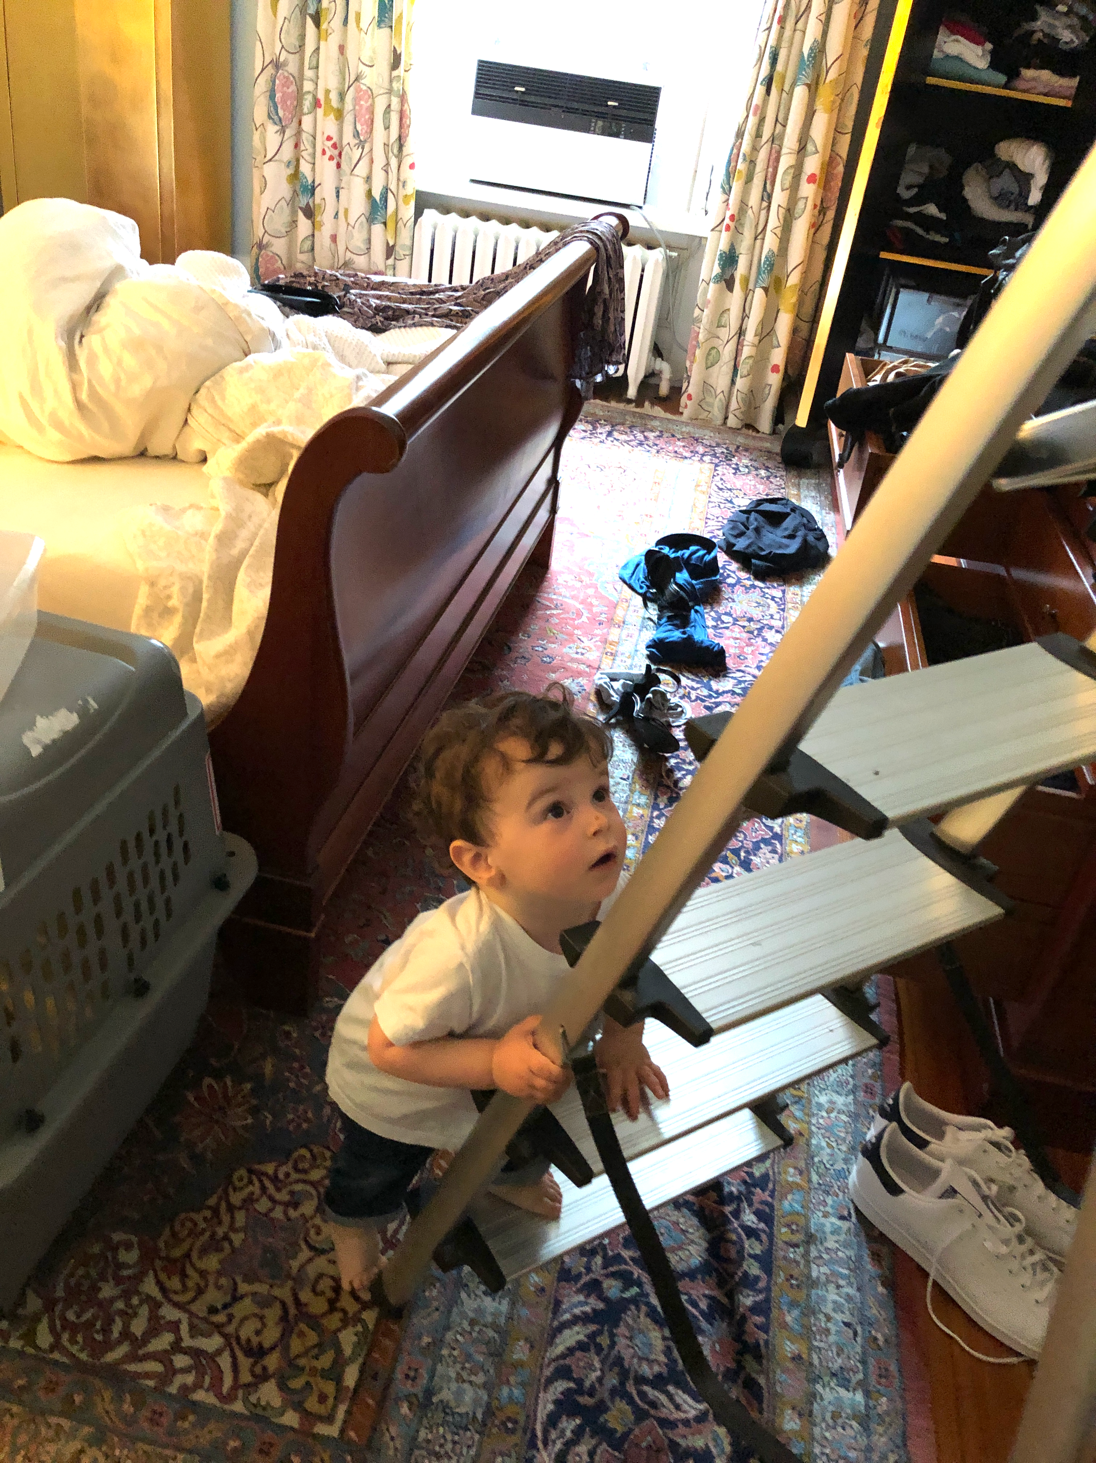
Toy example: childproofing

Slide 20
Childproofing
Problem to solve: keeping Gabriel from opening the laundry cabinet and eating a Tide Pod.
Need for an “institution”
Very small scale, single layer
Current process for solving the problem: constant surveillance, grabbing him whenever he opens the cabinet
Exhausting, risky
Other needs to accommodate
I need to be able to get access to cabinet, in order to do laundry

Slide 21
One way of modeling the situation
child
opens cabinet
doesn’t open
opens cabinet
adult
doesn’t open

Slide 22
One way of modeling the situation
child
opens cabinet
doesn’t open
+ does laundry
- sick child
-99
+ fulfills desire
- eats tide pod
+10? -150?
+ does laundry
- constantly running interference
-10
+ safe
- frustrated
-10?
opens cabinet
adult
- no laundry
- sick child
-110
+ fulfills desire
- eats tide pod
+10? -150?
- no laundry
- constantly running interference
-15
+ safe
- frustrated
-10?
doesn’t open

Slide 23
One way of modeling the situation
child
opens cabinet
doesn’t open
+ does laundry
- sick child
-99
+ fulfills desire
- eats tide pod
+10? -150?
+ does laundry
- constantly running interference
-10
+ safe
- frustrated
-10?
opens cabinet
adult
- no laundry
- sick child
-110
+ fulfills desire
- eats tide pod
+10? -150?
- no laundry
- constantly running interference
-15
+ safe
- frustrated
-10?
doesn’t open
Not particularly helpful

Slide 24
Changing the payoff
Possible to intervene to changes payoffs and hence choices
Thinking of an institution as transforming a game to another game
E.g., nail cabinet shut
Transforms status quo into the following:
child
opens cabinet
doesn’t open
+ does laundry
- sick child
- -99
+ fulfills desire
- eats tide pod
+10? -150?
+ does laundry
- breaks cabinet
-110
+ safe
- frustrated
-10?
opens cabinet
adult
- no laundry
- sick child
-110
+ fulfills desire
- eats tide pod
+10? -150?
- no laundry
- constantly running interference
-15
+ safe
- frustrated
-10?
doesn’t open
But this isn’t helpful either. The problem isn’t to transform choices away from the upper right

Slide 25
Types of interventions
Aim of intervention is to reduce the need to monitor and intercept child
Types of intervention:
Intervene with rules:
Rule for adult to stand next to cabinet at all times
Rule for child to stay away from cabinet (won’t work)
Hire full-time person to monitor cabinet
Intervene with infrastructure:
Nail cabinet shut
Playpen, fence
Other interventions?
Yes, obvious, but hold off for a second

Slide 26
Characterizing the status quo situation
Child sees cabinet
Child runs to cabinet
Child pulls on handle
Door opens
Child takes tide pod
Child puts tide pod in mouth
Adult thinks about laundry
Adult goes to cabinet
Adult pulls on handle
Door opens
Adult takes tide pod
Adult puts tide pod in washer
We naturally (and correctly) see this as a hybrid causal system, not merely one of a choice situation or an infrastructure problem
Aim is to block the first process with lowest cost and effort, while preserving the second process with lowest cost and effort

Slide 27
Characterizing the status quo situation
Objects
Child
Properties and relations
Height(x)
Mental states, capacities
Behaviors
Adult
Mental states, capacities
Bodily characteristics
Cabinet
Door
Handle
Cabinet contents
Tide Pods
Pulling_on(x,y)
Running_to(x,y)
Open(x); Closed(x)
Picks_up(x,y)
Puts_in_mouth(x,y)
Events
Space of “nomologically possible” events affected by constraints, affordances, costs, etc.
Bodily characteristics
Behaviors
Causal model of relations among these events
Parameterize the events, model variations among them
Can be structural or other model
These help delineate a range of places in which and between which we might intervene
E.g, interventions to block child running to cabinet, block child pulling on cabinet. Block child opening cabinet, block child taking tide pod from open cabinet, block child eating tide pod (better to stop before you get to that point)

Slide 28
Designing interventions
Child sees cabinet
Child runs to cabinet
Child pulls on handle
Door opens
Child takes tide pod
Child puts tide pod in mouth
Adult thinks about laundry
Adult goes to cabinet
Adult pulls on handle
Door opens
Adult takes tide pod
Adult puts tide pod in washer
Focus on particular steps, or process, break out causal system in more detail
Note height, knowledge, dexterity differences between child and adult
Exploit differential capacities
Generate hybrid: affordances of the cabinet are changed by a process that involves some rule-following, artifacts that require dexterity, and changes to the cabinet

Slide 29
The obvious interventions are hybrids
Magnetic-release latches
How the magnet works with the latch
Physical coordination and dexterity in process for opening latch
Rules for storing the magnet nearby, replacing it when done
Rules for when it’s ok to disengage the latch, re-engage it
Child safety latch may seem like infrastructure, but is a hybrid of rules and infrastructure
Doesn’t work without inducing cognitive states, routines, etc. in the adult
Yet obviously doesn’t consist of cognitive states alone
Manual-pressure latches
Somewhat different hybrid

Slide 30
Introducing kinds and introducing instances
Kind: child safety latch
Sub-kind: magnetic-release latch
Sub-kind: manual-pressure latch
Putting in place a “new institution”
Distinguish instantiating an existing kind from anchoring a new kind
Instantiating an existing kind
A hybrid artifact that realizes some function in a way that has already been worked out
Anchoring a new kind
New way for realizing function; still draws on existing kind-formation machinery

Slide 31
Method to search for transforming interventions
Identify current system, desired outcomes to improve
Map out components of system, causal interactions
Of which human contributions, choices, are just a part
Identify routes for transformation
Realizer search
Instance existing kinds, anchor new kinds
Empirical assessment

Slide 32
Searching more of the space of possible interventions
We do this implicitly in institution design
Actual institutions do not conform to the simple models of cognitive-interventions, infrastructural-interventions
But models are lacking
But don’t plenty of models accommodate hybrids?
As in economics – individual preference structures together with bundles of resources
Inseparability hypothesis:
Inadequacy of modeling institutions as simple hybrids

Slide 33
Inseparability
Object
Object
Cognitive states
Resources
Resources
Cognitive states
Cognitive states
Resources
Hypotheses:
Many (if not most) institutions are multi-level heterogeneous artifacts
Multi-level heterogeneous object cannot be adequately modeled as a single-level composite
Intuitively: can’t model a flan by modeling the properties of eggs, milk, sugar, vanilla
Even modeling simple hybrids severely limits the kinds of interventions that we consider

Slide 34
Space of possible interventions
A
B
A
B
A
B
A
B
C
The extent of prevailing models
A
B
Etc.
A
A
A
B
A
B
A
B
A
B
A
B
B
A
B
A
B
A
B
A
B
A
B
Homogeneously constituted interventions, together with simple hybrids, are a tiny fraction of those possible

Slide 35
Some takeaways
Shortcomings of prevailing approaches
Of cognitive treatments of institutions
Rules and equilibria approaches, new institutional economics, organization theory
Of return to infrastructure
Opportunity to develop new approaches to modeling and policy design
Without giving up on systematicity
Build on examples of heterogeneous realizers
Also not just simple tokens, but introduction of institution-kinds and considering stratified institutions

